Slide 1
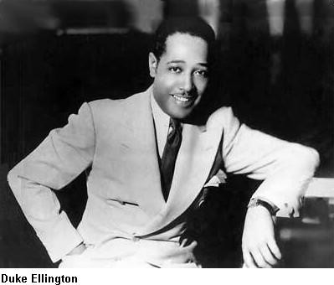
Duke Ellington
By Isabel Vera #33 10/16/12

Slide 2
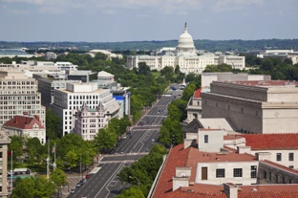
Date of birth
Edward Kennedy Ellington was born April 29,1899 in the city of Washington, D.C. He was born to Daisy Kennedy Ellington and James Edward Kennedy, both pianist.

